Slide 1
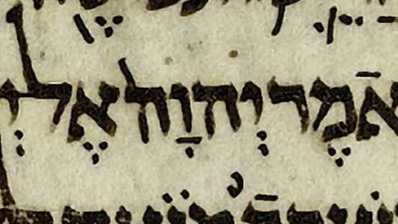
Linguistic Dating of the Hebrew Bible
Aren Wilson-Wright
Notes:
This project was inspired by my previous career as a scholar of ancient languages; it uses deep learning to help solve a persisent problem in the study of ancient Hebrew

Slide 2
Problem and Rationale
Archaic Biblical Hebrew (ABH) 1200-1000 BCE
Classical Biblical Hebrew (CBH) 1000-586 BCE
Transitional Biblical Hebrew (TBH) 586-539 BCE
Late Biblical Hebrew (LBH) 539- BCE
Notes:
although a few texts in the Hebrew Bible / Old Testament refer to historical events and can be securely dated, most do not. As a result, biblical scholars like Avi Hurvitz have used linguistic dating in order to establish a chronological horizon for undated texts. So far these scholars have largely worked “by hand,” laboriously sifting and weighing individual linguistic features. Their research suggests that the Hebrew language passed through four phases. In many texts, however, the chronological signals are too faint for human researchers to detect and so these texts remain unassigned.
What we have here is a combination o two problems: NLU and classification; the goals of the project, therefore, were to develop a robust language model for biblical Hebrew and a classification algorithm that could sort the texts of the Hebrew bible into chronological phases automatically.

Slide 3
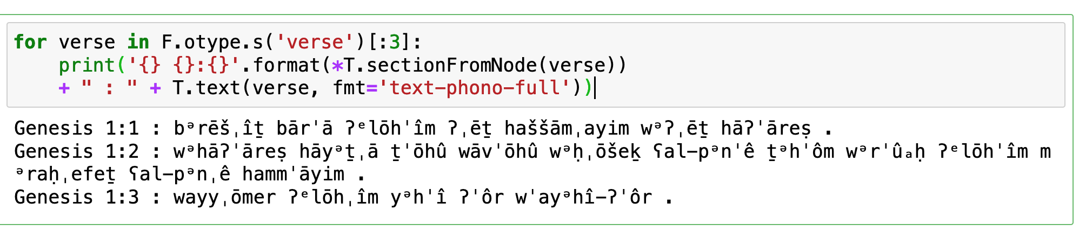
Sourcing Data: Text-Fabric
https://annotation.github.io/text-fabric/tf/index.html
Notes:
a python package created by scholars at the Vrije Universiteit Amsterdam for preforming statistical analysis of the bible and other ancient texts; it is organized as a network of interlocking nodes representing words, clauses, sentences, verses, and chapters, which makes it very different than a structured . The transcription system that they used was idiosyncratic and included unneeded elements like accent marks and section breaks. So I needed to preform a lot of data cleaning before I could begin EDA.

Slide 4
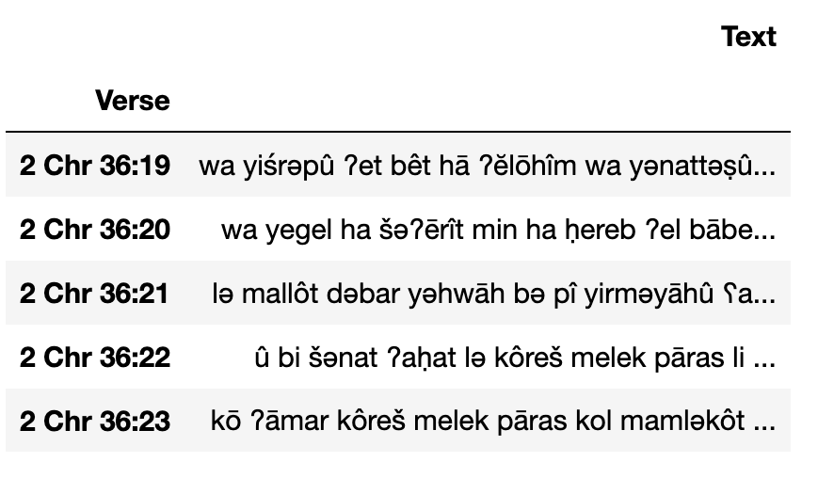
Data Wrangling 1
Notes:
I extracted the text of each verse into its own row; fixed the transcription system; added a column for chapter and verse numbers; updated the chapter names to fit scholarly convention; set verses as an index to make the DataFrame easier to navigate; fixed a problem (1 kgs 16:26-27 treated as a single verse); remove Aramaic texts

Slide 5
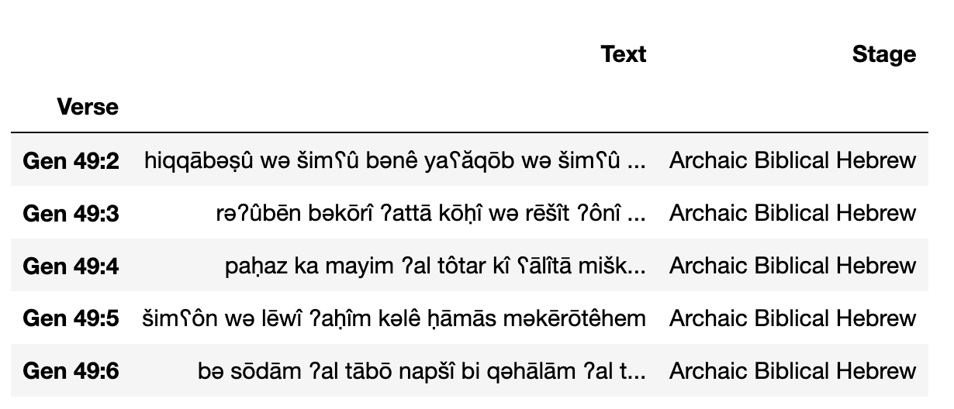
Data Wrangling, Part 2
ABH: 307 Verses
CBH: 3042 307 Verses
TBH: 2956 307 Verses
LBH: 2087 307 Verses
Notes:
I then created labeled and unlabeled data sets; I applied the labels myself using my own expertise in the field; it was here that I ran into a problem, however. The number of ABH verses was a whole order of magnitude smaller than the other samples. So to avoid having unbalanced data, I down sampled the other three groups. In theory, I could have generated artificial data points for ABH, but that may have led to overfitting.

Slide 6
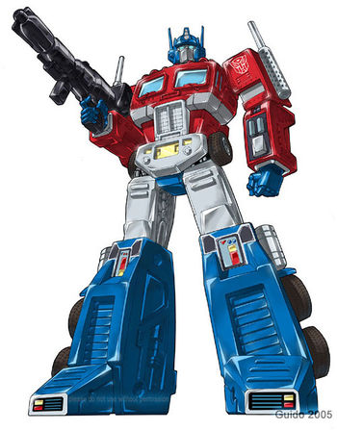
A Brief History of Language Models
Bag of Words, TfIdf
Word2Vec, LSTM
Transformers
Notes:
Computers cannot understand natural language, but they can understand numbers. Much of NLP involves finding ever better ways to translate language into vectors. One area where language models have really improved is contextual semantics.
The meaning of words is contextual; that is, it depends on surrounding words; the earliest word embedding algorithms (such as bag of words or TFID), however, could not capture this contextual information. Subsequent embedding algorithms like Word2Vec and LSTMs were able to capture some of this contextual information, but had a limited range (5-20 words)
The latest language models are able to (in theory at least) capture an unlimited amount of contextual data by using the Attention mechanism; it all depends on

Slide 7
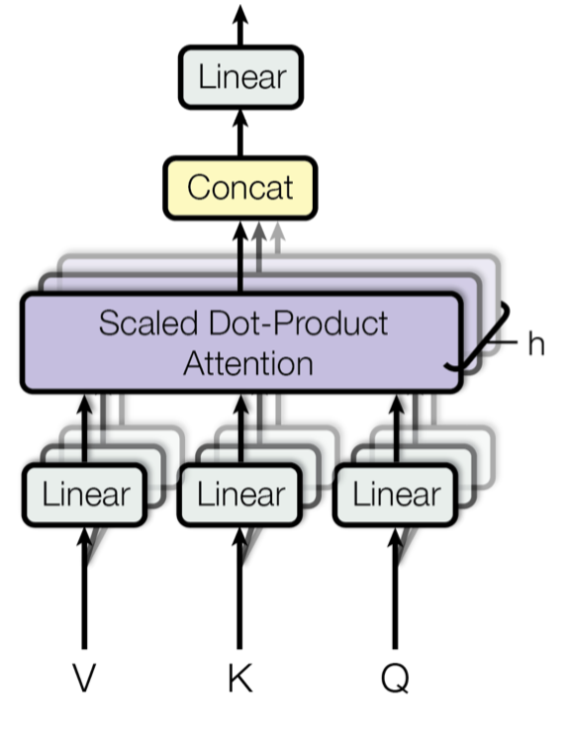
The Attention Mechanism
softmax(QK^{T}/√d_{k})V
During training 15% of words are “masked” and the algorithm learns to predict the masked words
Notes:
a function encodes the position of each token in the sentence; each token is represented by three vectors, a query vector, a key vector and a value vector; the softmax function tells us which other words are most relevant for understanding a given word; the value vector represents theses words’ contribution to the meaning of the given word
multiple attention layers working in parallel (12); each layer learns something slightly different about the sentence; finally, the outputs of the attention layers are concatenated and passed to a forward feed layer
During training 15% of words are “masked” and the algorithm learns to predict the masked words

Slide 8

From RoBERTa to BERiT
https://huggingface.co/gngpostalsrvc/BERiTmodel2
Notes:
I wanted to use a Transformers architecture for my Biblical Hebrew language model; but there are many options to choose from: autoencoding, autoregressive and sequence2sequence. The choice of language model depends in part on the task you want to accomplish: autoencoding models are good for natural language understanding, autoregressive are good for natural language generation, and sequence2sequence models are good for translation. My project involves natural language understanding, so an autencoder is the best choice. But that still leaves plenty of options.
I ultimately opted for a RoBERTa architecture because RoBERTa uses a byte level Byte-Pair Encoding tokenizer which can handle non-standard characters better than workpiece or unigram tokenizers. Like RoBERTa, the names of most autoencoding algorithms contain a play on BERT, the name of the first autoencoding algorithm. I named my language model BERiT after the biblical Hebrew word for covenant.
Once I had chosen an appropriate architecture, I used the huggingface transformers library to train my model for 10 epochs on a Telsa P100 GPU using Google Colab. The model can be accessed through the huggingface hub or using the transformers API
The outputs of the model are 768 dimensional embedding vectors

Slide 9
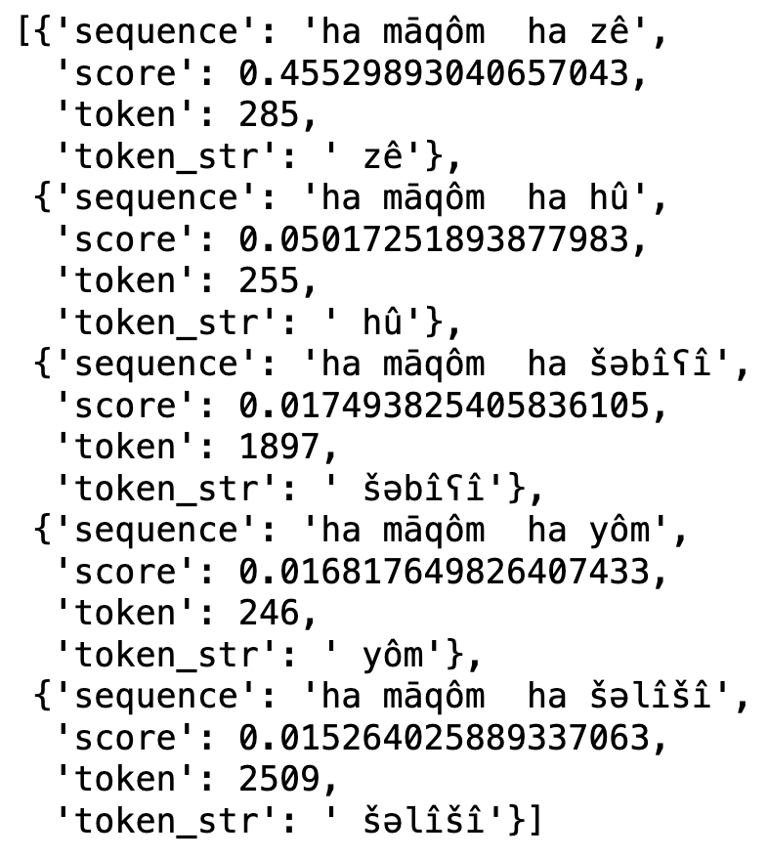
Outcome of the Training
This place
That place
The seventh place
The place today
The third place
ha māqôm
ha <mask>
Notes:
After running training, I performed a couple of sanity checks on the model. The slide shows the outcome of asking BERiT to predict the next word in the phrase ha māqôm ha <mas>.
The top two options are incredibly common in the Hebrew Bible, and in two of the remaining cases, the model correctly identifies the masked word as an adjective. So the model has a pretty good understanding of Biblical Hebrew as a language; but does it capture any chronological information?

Slide 10
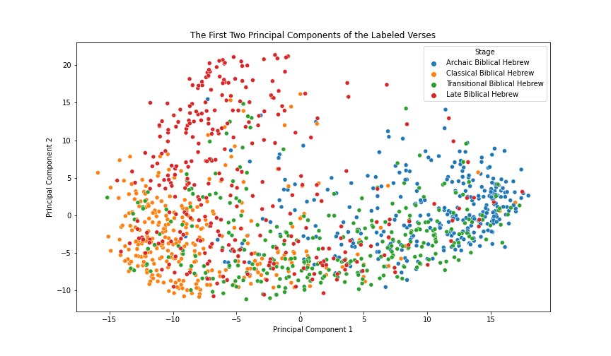
Exploratory Data Analysis 1
Notes:
To check whether this was the case, I plotted the first two principal components of the labeled verse embeddings to see whether they formed (relatively) discrete clusters)
The groupings are not as clear as I would have hoped. Although ABH, CBH, and to a lesser extent LBH cluster in distinct regions of the graph, TBH is much more diffuse, overlapping significantly with ABH and CBH. It is important to remember, however, that language change is a slow, continous process. For every linguistic feature that changes, many others remain the same. Areas of overlap between the different stages may represent verses that contain fewer distinctive chronological features. It's also possible that the four groups are more easily distinguishable in higher dimensions.
The position of TBH is particulalry strange because TBH represents the transitional phase between CBH and LBH and so we would expect it to overlap with these groups. One possible explanation for this outcome is that TBH texts contains a mixture of poetry and prose, while CBH and ABH texts are predominantly written in either poetry (ABH) or prose (CBH). But such a hypothesis does not not explain why TBH does not overlap as much with LBH, which is also written primarily in prose.
As a final test, let's see how the actual grouping compares to the clusters generated by an unsupersived learning algorithm.

Slide 11
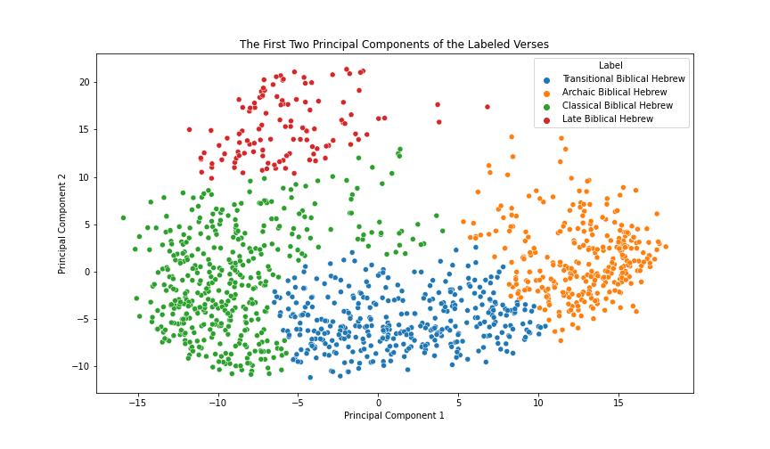
Exploratory Data Analysis 2
Notes:
Here’s an agglomerative clustering of the same data; it’s hard to tell visually how far off the actual data is from this ideal clustering; to get a better sense of this, I created a heatmap of predicted vs actual label

Slide 12
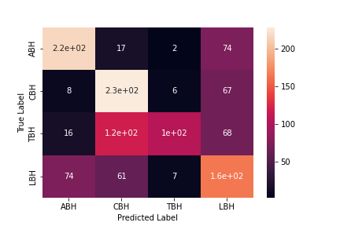
Exploratory Data Analysis 3
Heatmap of Actual and Predicted Label
Notes:
Well that's a relief! The actual grouping matches the clusters generated by unsupervised learning remarkably well for ABH, CBH, and TBH. LBH remain problematic, having lost nearly half of its datapoints to CBH. But I felt more confident now that the verse embeddings capture chronological information and could move on to classification
first I needed to do a little preprocessing: dividing the data into predictor and response variables (i.e., sentence embeddings and chronological data), encode the categorical data, and divide both into a .8-.2 train/test split.

Slide 13
Building the Classification Model
Number of nodes in each dense layer (32–1152)
Dropout rate (15–25%)
Number of Layers (1–4)
Activation function (tanh, relu, selu, and softsign)
Weight initialization function (Glorot normal vs He normal)
Notes:
I started with a dense layer followed by a dropout layer and softmax output layers
I used Bayesian optimization to tune the following hyperparameters over 50 epochs with early stopping (training was much faster with a shallow neural net than the Roberta model, so I could afford to train for longer); I used accuracy at the optimization metric since I would like the model to be able to preform equally well on each class (no special concern for TPR or FPR).
using dense layers that are larger than the input can lead to overfitting, so it’s important to adjust the dropout rate to compensate for that
He normal initialization can prevent exploding or vanishing gradients in deep nns that use the relu activation function, but my model was too shallow for it to have a significant effect over the default Glorot initialization

Slide 14
Model Architecture
Dense Layer (576 Nodes)
}
Relu
3x
Dropout Layer (16%)
Dense Layer (4 Nodes)
Softmax
ABH
CBH
TBH
LBH
Notes:
This is what the final model looked like

Slide 15
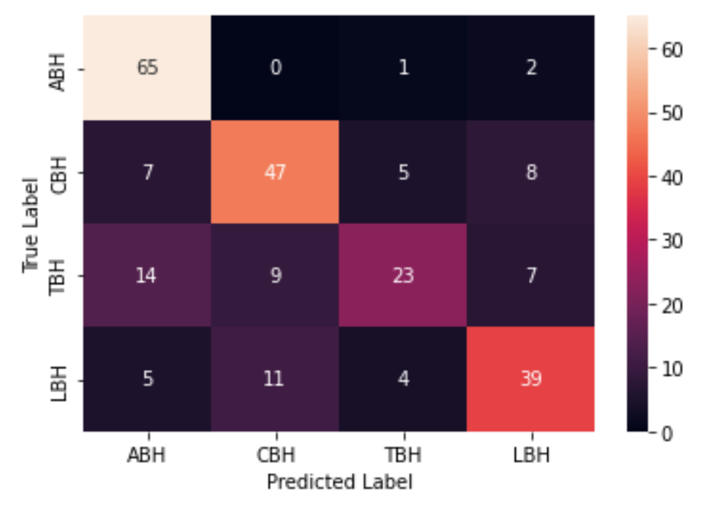
Results
Heatmap of Actual vs Predicted Labels
71.2% accuracy
Notes:
The best model achieved 71.2% accuracy on the labeled training data, which is pretty impressive considering the size of the data set (1228) (and my limited computational resources for hyperparameter tuning ☺)
I created a heatmap to see where the model was struggling
Very good at identifying ABH; not as good at identifying CBH and LBH; struggles the most with TBH as we saw with the clustering of the principal components

Slide 16
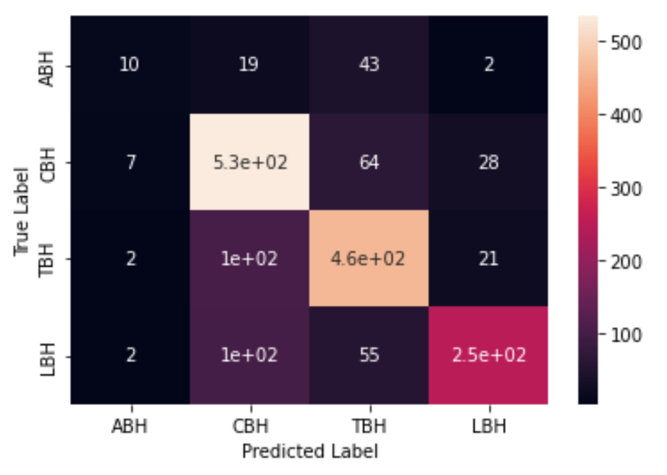
Results using All Labeled Data
Heatmap of Actual vs Predicted Labels
73.8% accuracy
Notes:
I was curious whether I could improve the models performance by training it on the full labeled data set rather than the subsampled one; doing so resulted in a 2.6% increase in accuracy at the expense of being able to distinguish ABH; this isn’t a great trade off in my opinion

Slide 17
Areas for Improvement
Clause level analysis
Further tuning of BERiT
Further tuning of the classification algorithm
Up-sampling the ABH data / dropping ABH data
Interpretability
Notes:
improve performance by training for more than 10 epochs; try additional configurations of the classification algorithm to try and boost accuracy further; upsample the ABH data or drop it entirely so that it is possible to use more data at a time

